Slide 1
Lake County 2050
General Plan Advisory Committee
Meeting #3, Part 2
February 20, 2025

Slide 2
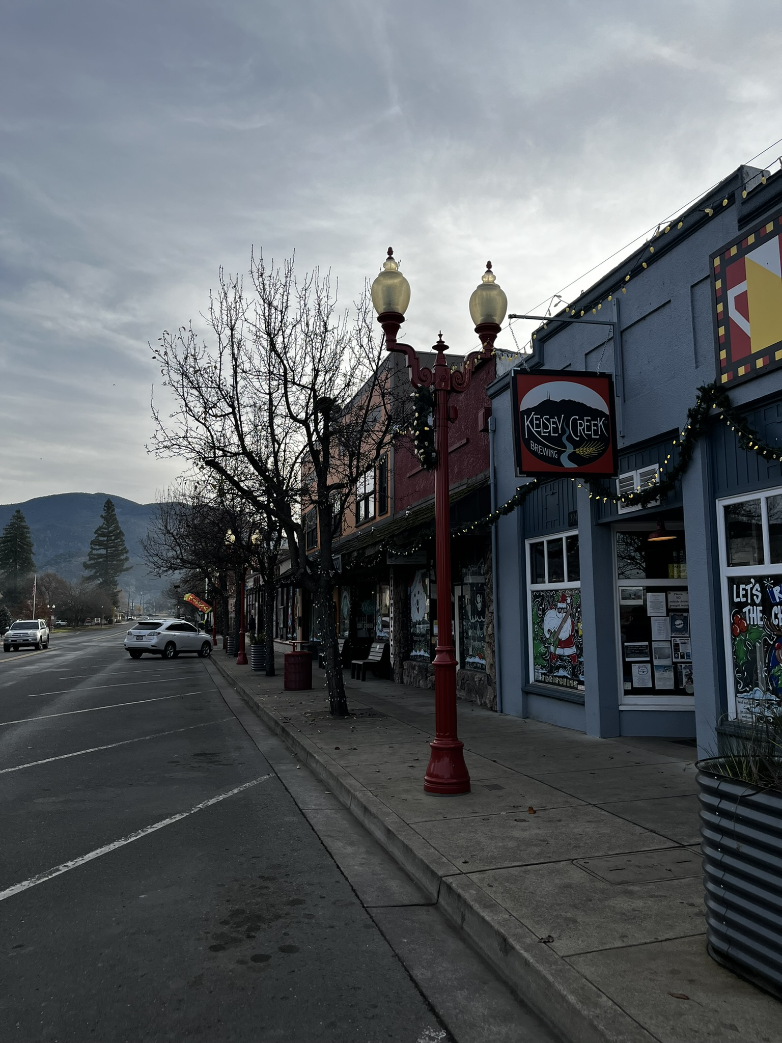
Meeting Overview
Welcome & Agenda Review
Housing Action and Implementation Plan (HAIP) Overview
Update on Requests from 2/13/25 GPAC Meeting
LAPAC-Recommended Community Growth Boundary Changes
LAPAC-Recommended Planning Area Boundary Changes
Discussion: Countywide Recommendations to the Board of Supervisors
Next Steps

Slide 3
Housing Action and Implementation Plan (HAIP)
Components of the HAIP
Analysis of Current Conditions
Community Engagement Summary
Gaps Analysis
Goals and Strategies
Action Steps and Resources
Site Inventory and Analysis
Online, interactive webmap
Comprehensive manual to address housing demands throughout Lake County
Related to, but not a part of the General Plan

Slide 4
Key Findings from Analysis and Outreach
Identified needs for a variety of housing types and levels of affordability
Support for amending zoning regulations to be more flexible and speed up residential construction
Community considers maintaining and rehabilitating homes and neighborhoods as a high priority
Strong support for residential infill development
Focus development away from agriculture, open space and wildfire hazards
Reduce the need to expand infrastructure
Provide access to retail, restaurants, offices, parks and other amenities
Connect with transportation networks that are walkable and bikeable

Slide 5
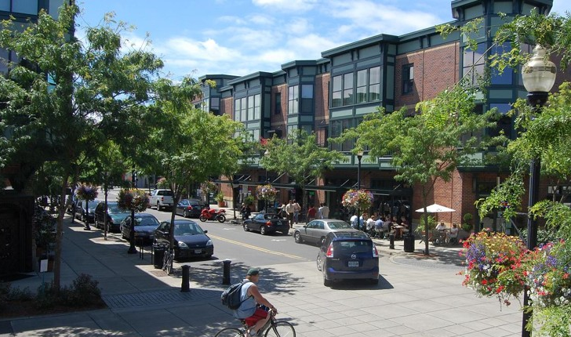
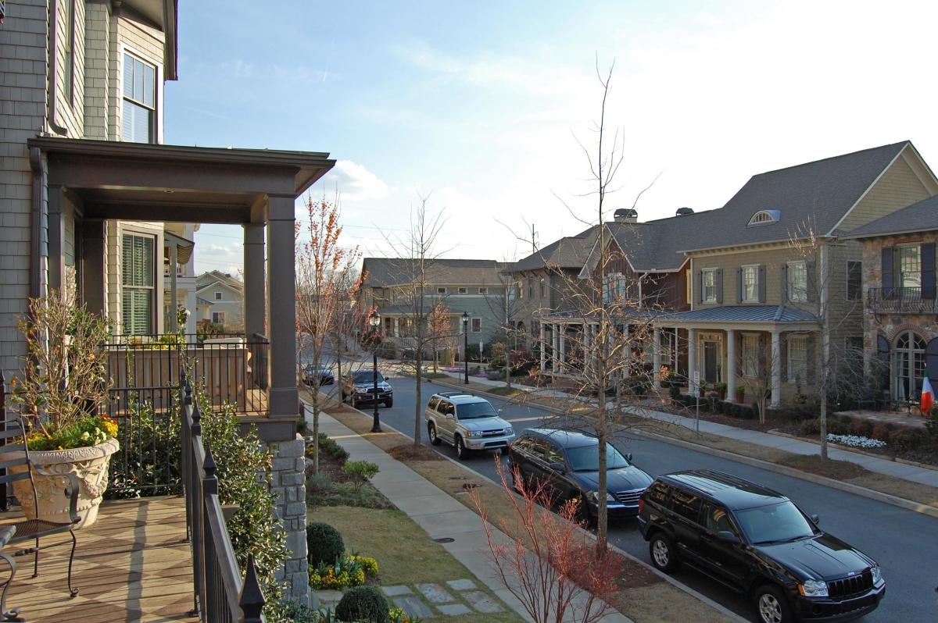
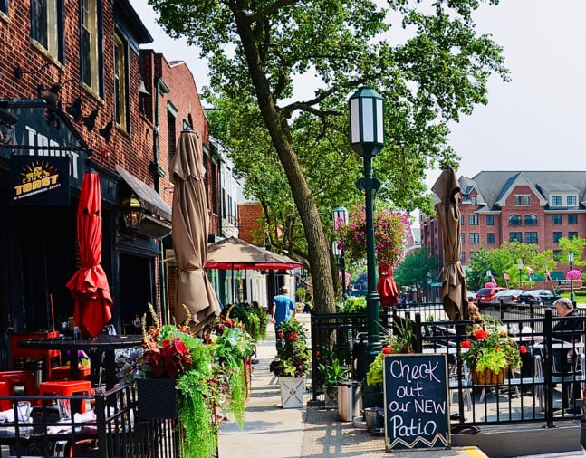
Mixed-Use, Walkable Neighborhoods
Clockwise from top left: Orenco Station, Or.; Montpelier, Vt.; Glenwood Park, Ga.; Birmingham, Mi.

Slide 6
Mixed-Use Infill Combining District
Purpose and Vision:
Encourage infill development, preserve surrounding rural character
Allow a greater variety of types of residential development
Design for walkability, connectivity, and access to amenities
Proposed Process:
Discuss concept with GPAC and LAPACs
Implementation Action in LAPs for County to work with the community to identify criteria for applying a future combining district (location, existing uses, access or other findings)
During future Zoning Code update, determine specific language for the combining district and apply where appropriate
Notes:
GPAC is an advisory committee.

Slide 7
Questions?

Slide 8
Community Growth Boundaries
Designated areas defining where future development should be focused.
Policy guidance in the General Plan specify certain allowances within versus outside of Community Growth Boundaries (CGBs)
Notes:
GPAC is an advisory committee.

Slide 9
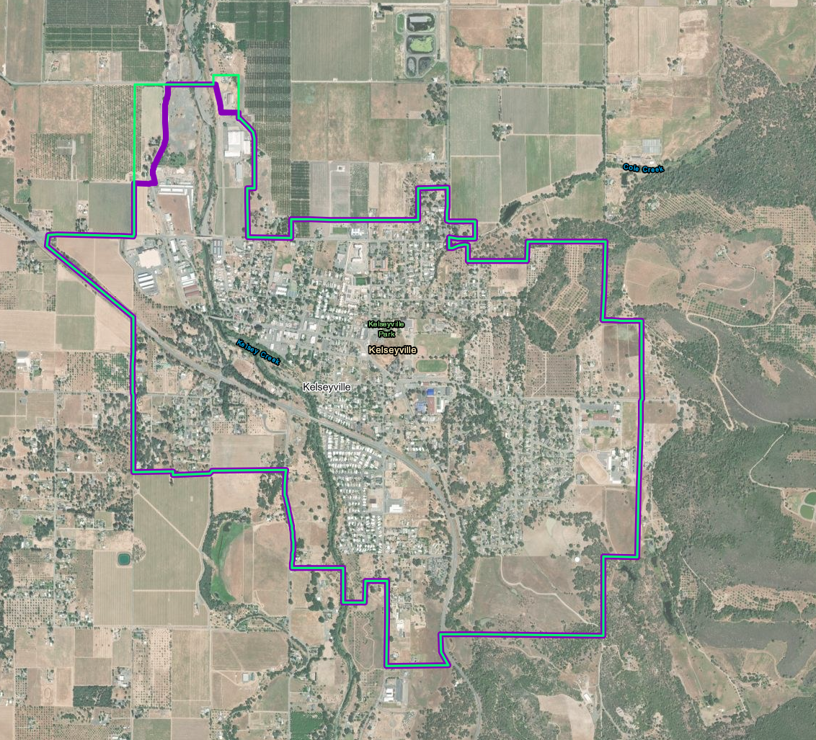
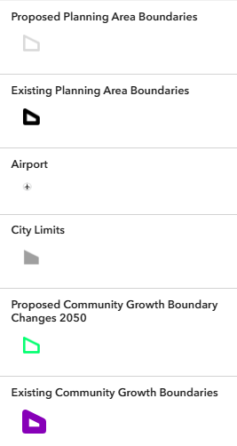
Kelseyville CGB
Notes:
Proposed expansion in the northwest corner of the Kelseyville CGB. Land is designated Agriculture in the western area proposing to be expanded and designated Industrial in the eastern portion proposing to expand

Slide 10
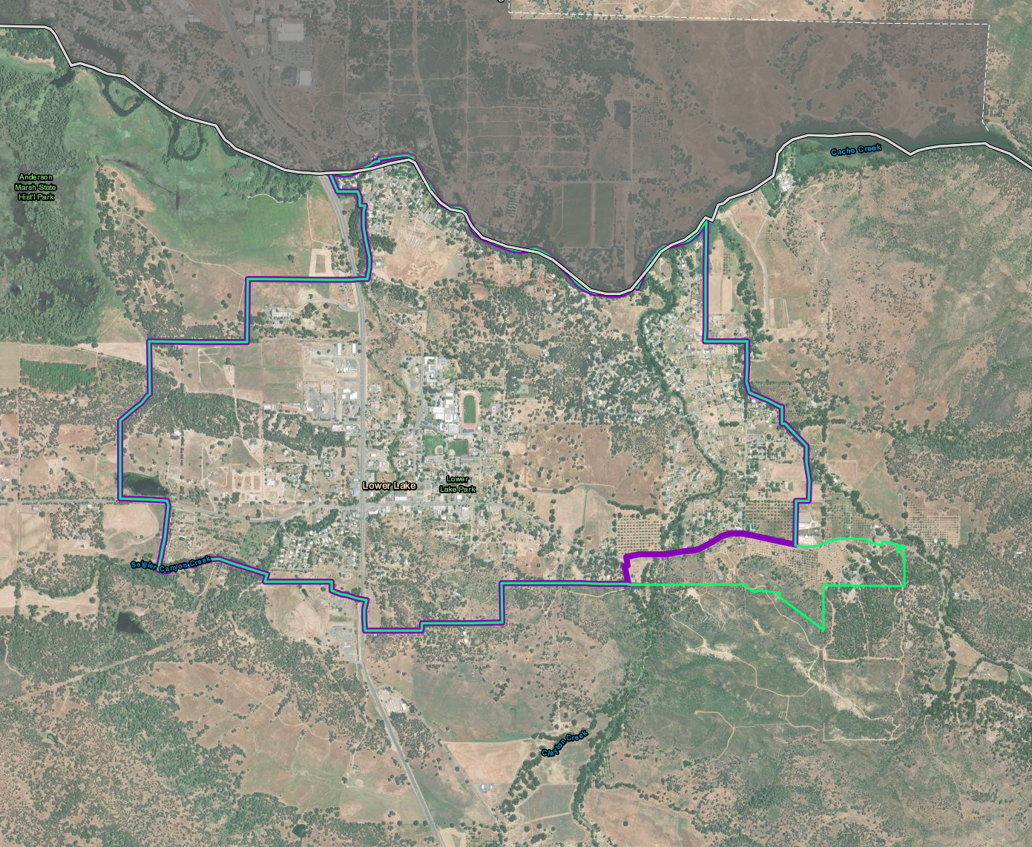
Lower Lake CGB
Notes:
Expansion in the southeastern part of the Lower Lake CGB. Expansion Area is currently Suburban Residential Reserve

Slide 11
Questions?

Slide 12
Planning Area Boundaries
Boundaries of the eight planning areas: Cobb Mountain, Kelseyville, Lakeport, Lower Lake, Middletown, Rivieras, Shoreline Communities, and Upper Lake-Nice
Some elements in the updated General Plan will be prepared at the planning area level, with policy guidance specific to the planning area: Land Use; Circulation; Open Space, Conservation, and Recreation; Environmental Justice; Public Facilities and Services; and Economic Development
Other local policy and decision-making process sometimes occur at the planning area level
Notes:
GPAC is an advisory committee.

Slide 13
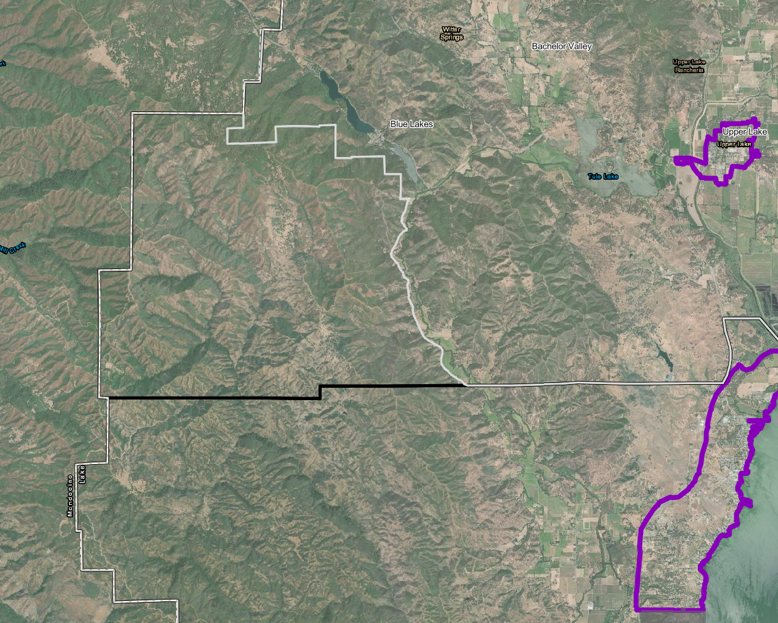
Lakeport/Upper Lake-Nice Boundary
Upper Lake-Nice
Lakeport
Notes:
-Entire community of Blue Lakes remains in Upper Lake/Nice. Land is designated Public Lands, Rural Lands, or Resource Conservation (along tributaries)

Slide 14
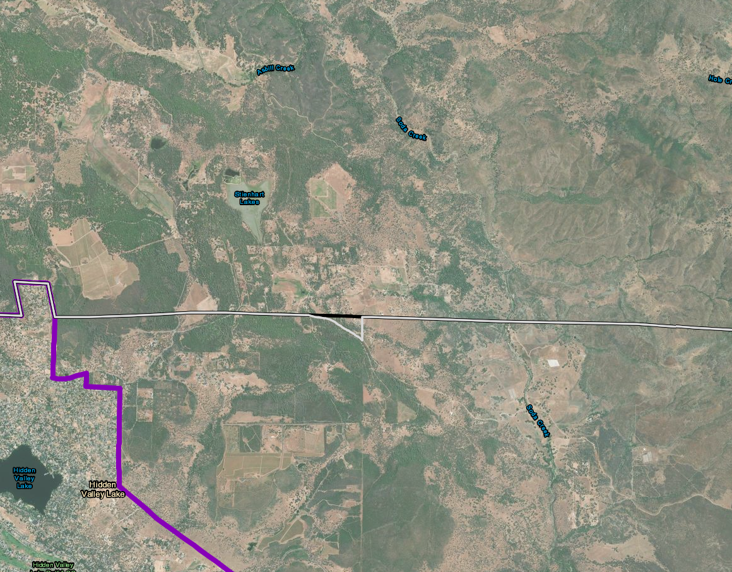
Lower Lake/Middletown Boundary
Lower Lake
Middletown
Notes:
Very small change to include all of Jerusalem Grade subdivision within the Lower Lake Planning Area. Currently part of it is in Middletown. All parcels are Rural Residential

Slide 15
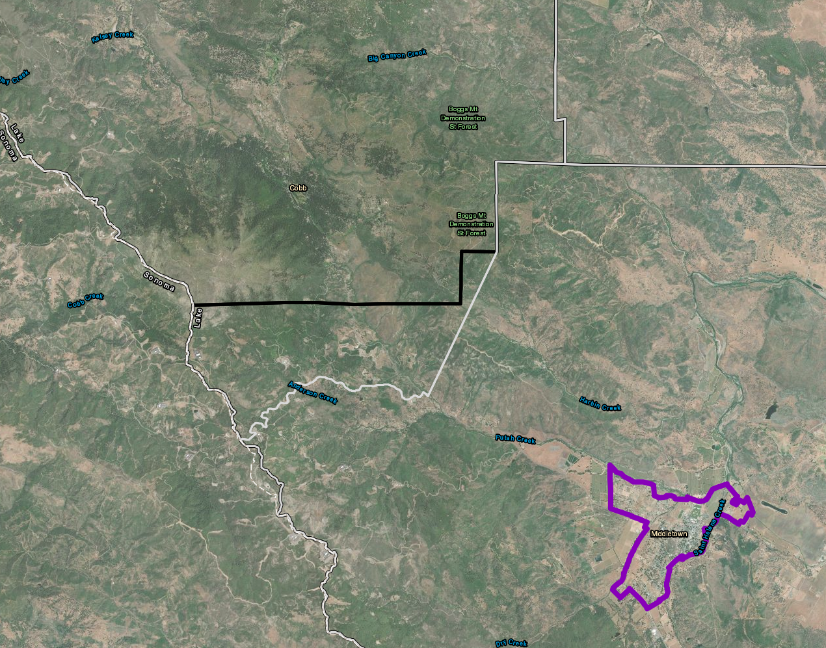
Middletown/Cobb Mtn Boundary
Cobb Mountain
Middletown
Notes:
Land is all Rural Residential and Resource Conservation along riparian corridors/tributaries, plus one Industrial-designated parcel

Slide 16
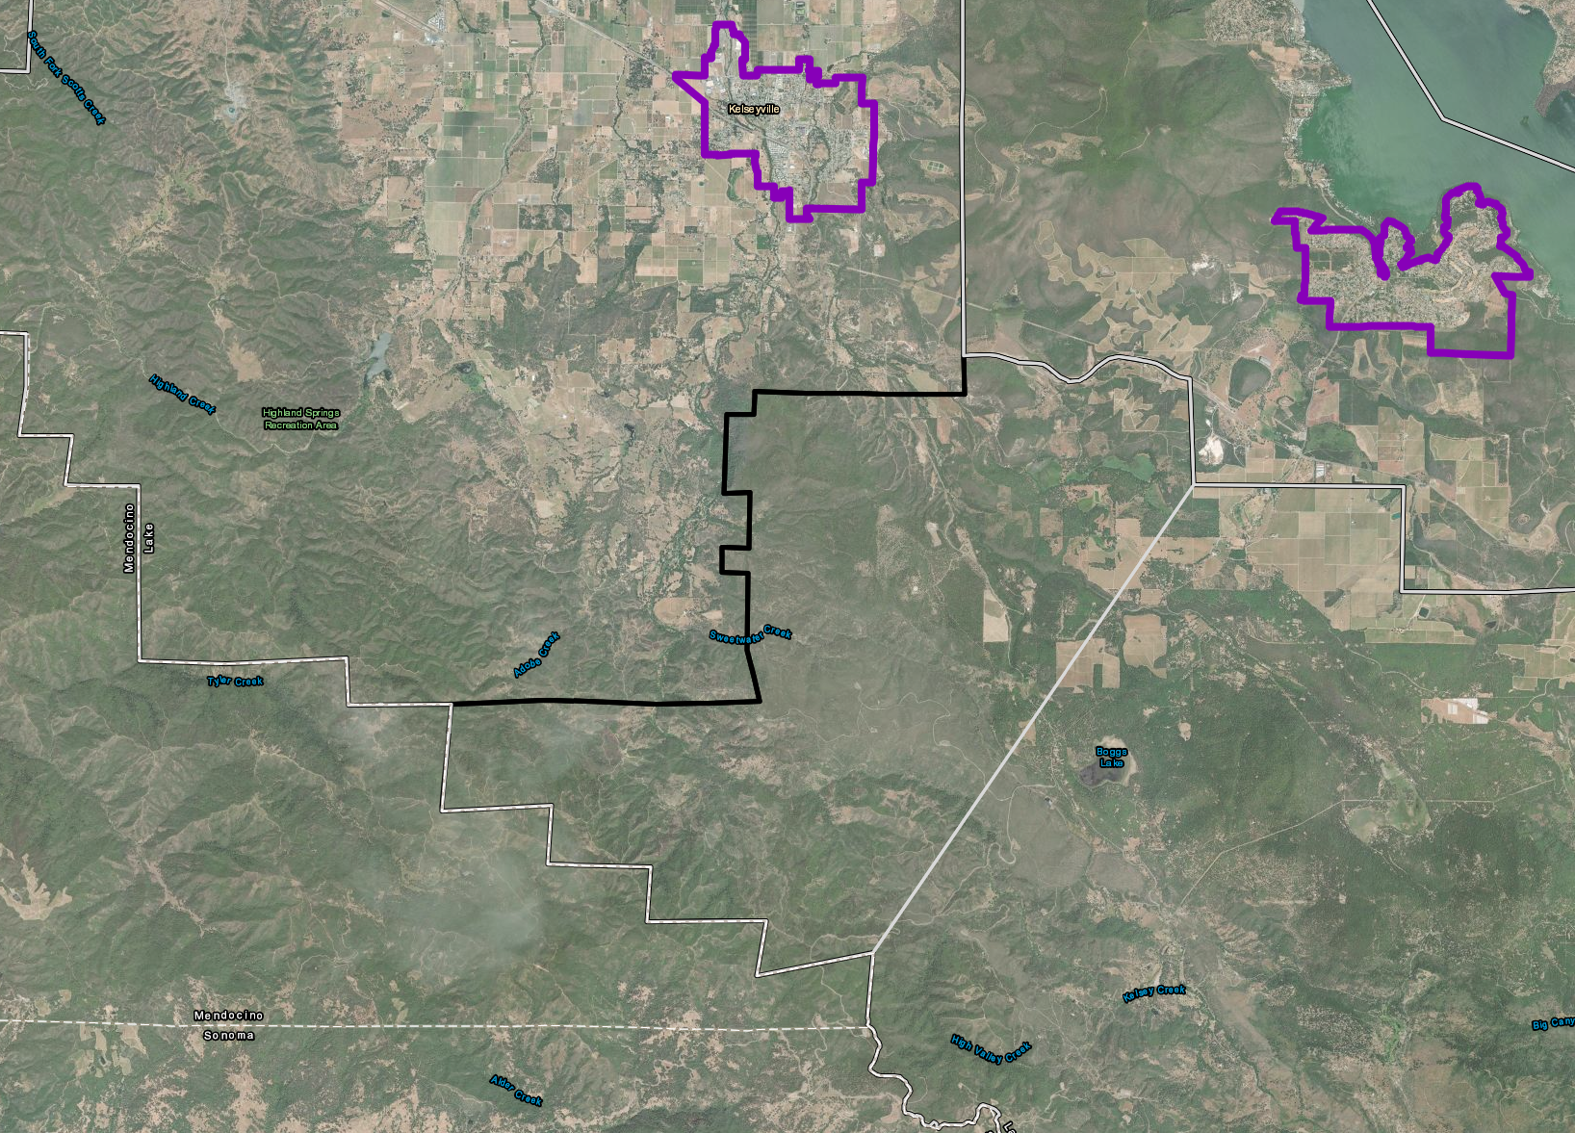
Cobb Mtn/Kelseyville Boundary
Kelseyville
Cobb Mountain
Notes:
Area is primarily Rural Lands, Resource Conservation, Agriculture, and a small amount of Suburban Residential Reserve above Boggs Lake.

Slide 17
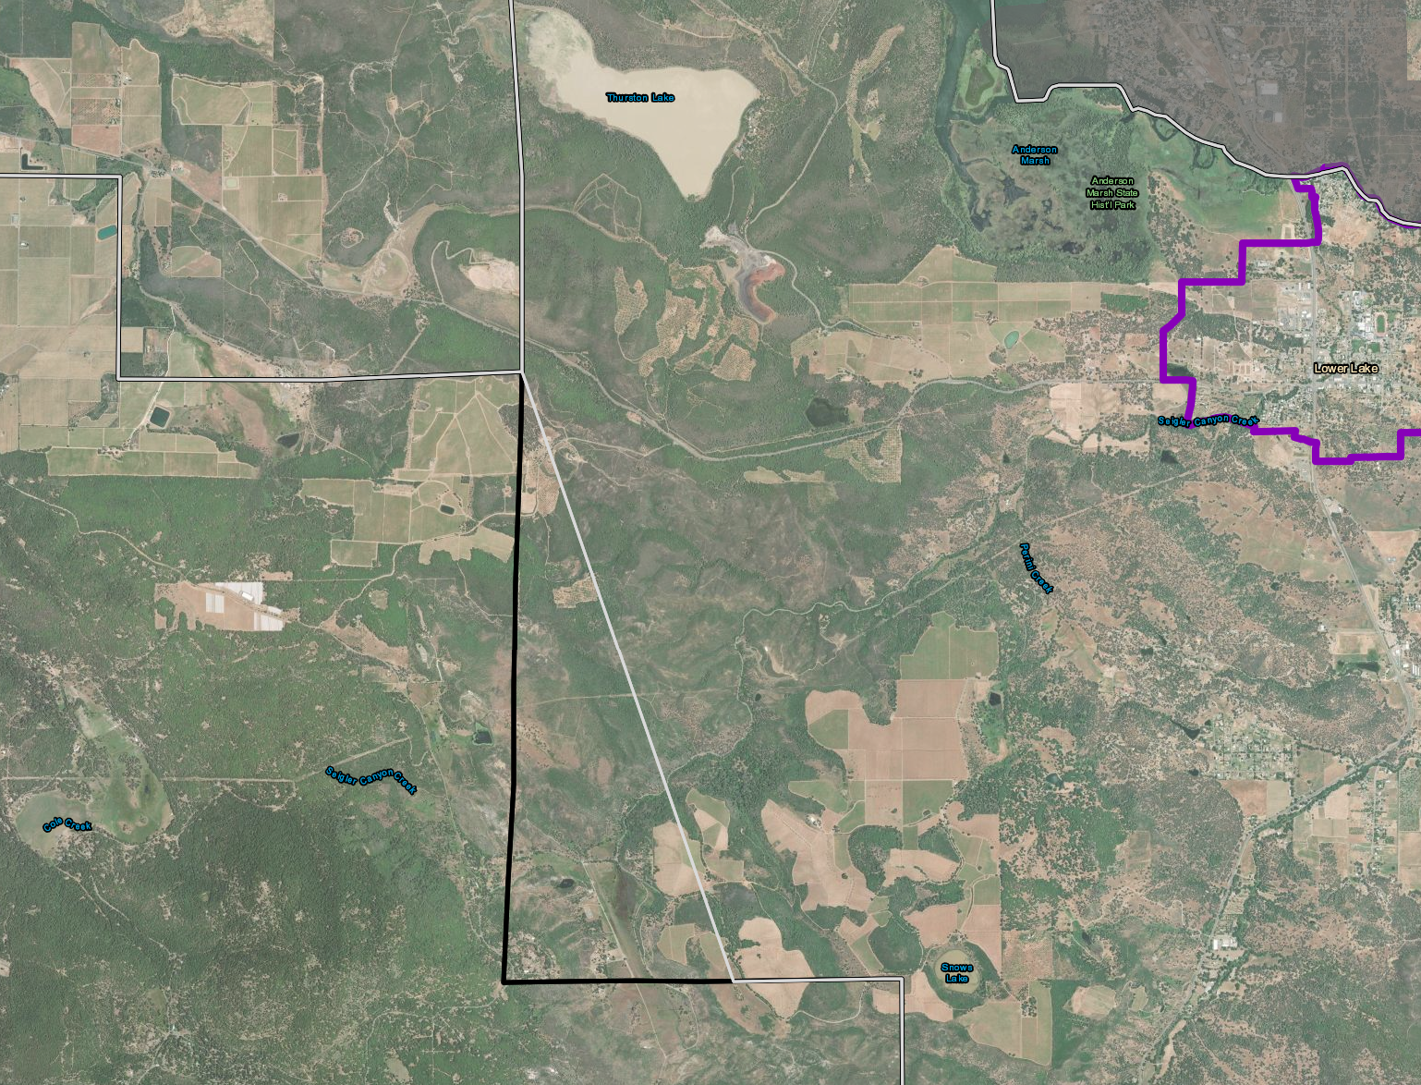
Cobb Mtn/Lower Lake Boundary
Lower Lake
Cobb Mountain
Notes:
-Area includes Siegler Springs subdivision and is designated Rural Lands, Rural Residential, Suburban Residential Reserve (a few parcels discussed at the last GPAC meeting being proposed to change to Local Commercial as a ‘rural hamlet’) and some Agriculture

Slide 18
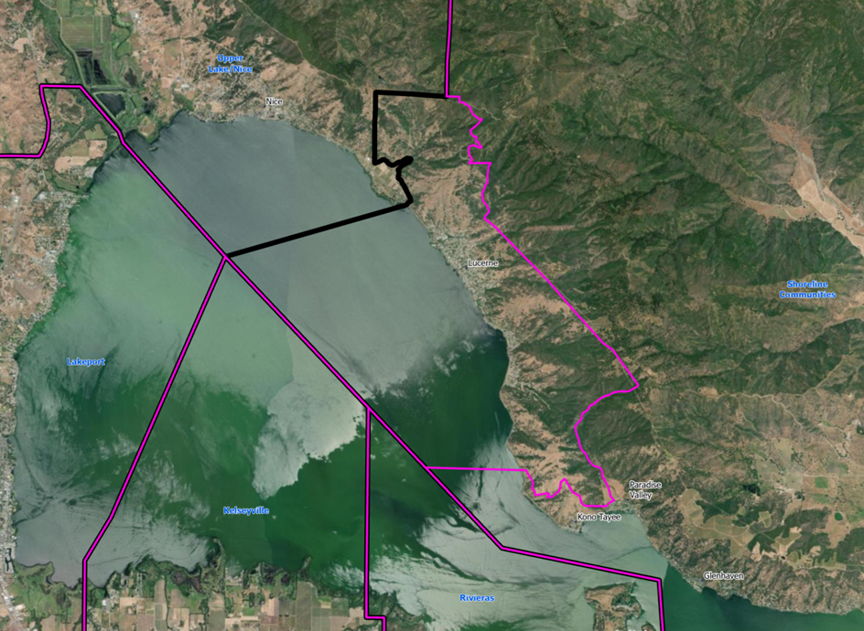
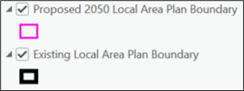
Upper Lake-Nice/Shoreline Communities Boundary
Upper Lake-Nice
Shoreline Communities
Notes:
We used zip codes 95458 and 95464 to extend the Upper Lake/Nice PA boundary southeast to include all of Lucerne, but modified the zip code boundary to exclude Kono Tayee, which remains in Shoreline Communities.
Zip code 95458 is the one Mireya asked me to use because it is the Central Region Town Hall (CeRTH) boundary, but this one includes Kono Tayee and does not include the northern part of Lucerne, and also does not intersect with the Upper Lake/Nice Boundary
We included zip code 95464 because it includes the northern part of Lucerne and intersects with UL/N

Slide 19
Questions?

Slide 20
Next Steps
Tuesday, March 11: Board of Supervisors Meeting
Review revised GPLU map and boundary changes
Phase | Schedule
Project initiation, background research, website/initial outreach | Fall 2023 – Spring 2024
Prepare Draft General Plan (including countywide and planning area elements) | Winter 2024/2025-Fall 2025
Prepare Environmental Impact Report | Spring 2025 – Winter 2025/2026
Public Review and Adoption | Spring – Fall 2026

Slide 21
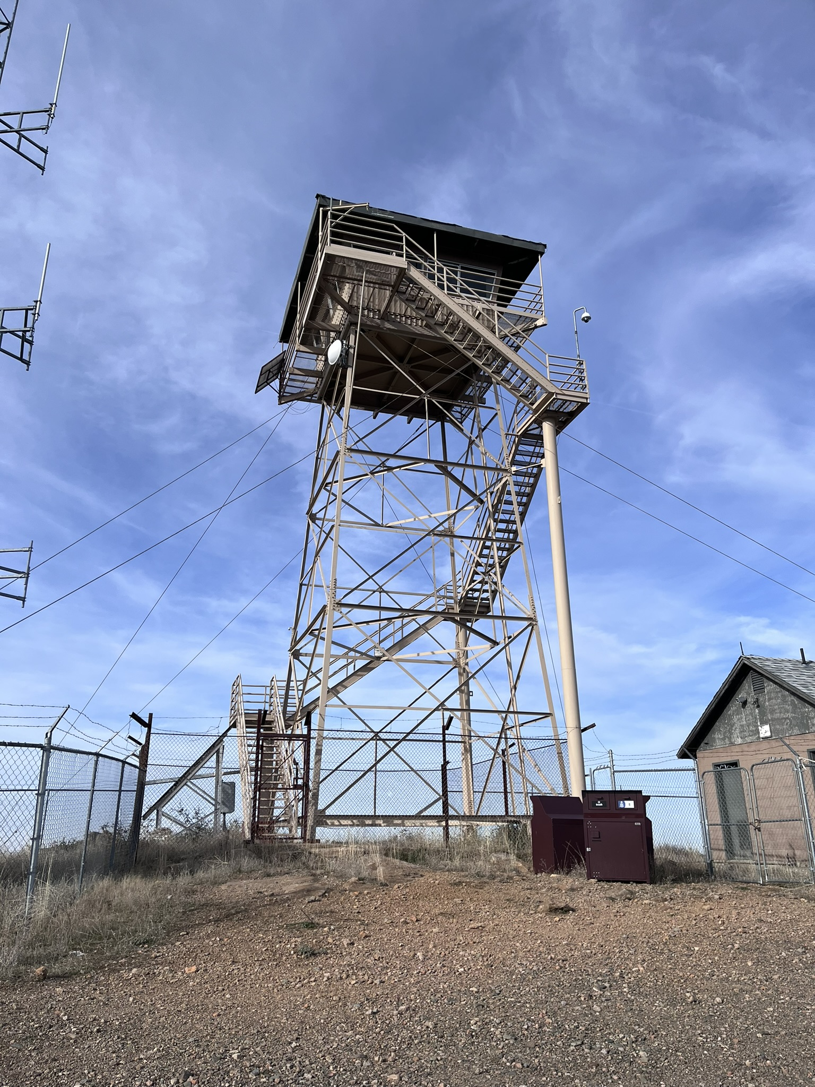
GPAC Meetings Schedule
Meeting 1: March 15, 2024
Learn about Lake County 2050
Review roles and responsibilities
Review Community Engagement Plan
Meeting 2: June 28, 2024
Review Draft General Plan Overview Document
Provide input on key policy issues
Meeting 3: February 13, 2025, and today
Review Draft General Plan Map and Boundary Changes
Meeting 4: Winter/Spring 2026
Review Draft General Plan (Countywide Elements)
Meeting 5: Winter/Spring 2026
Review Draft General Plan (Planning Area Elements)

Slide 22
Thank You

Slide 23
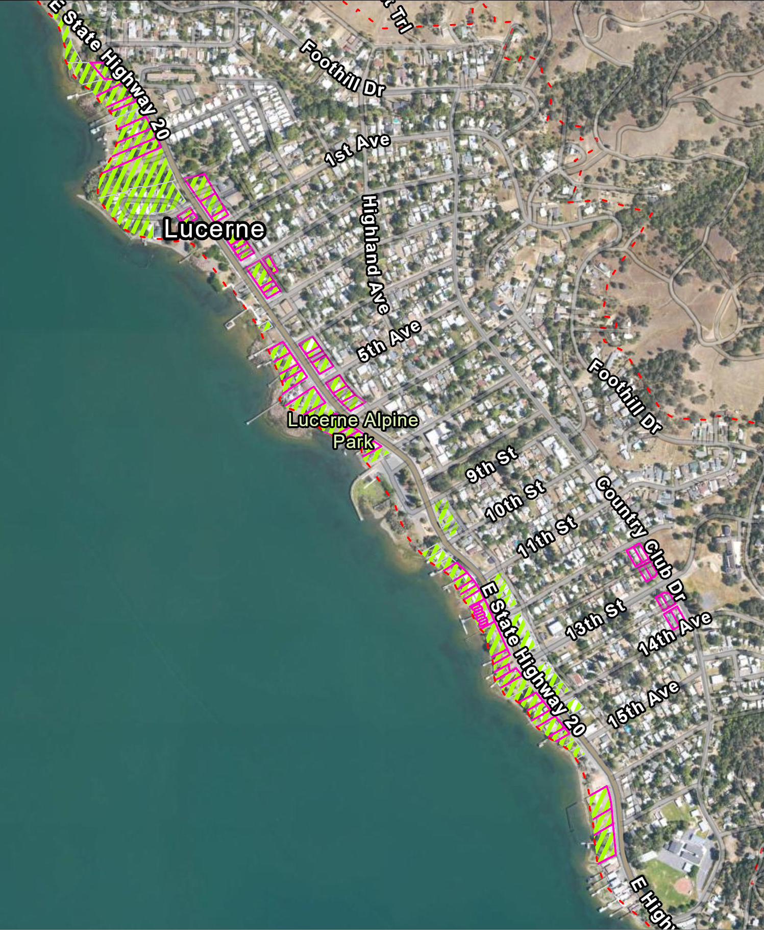
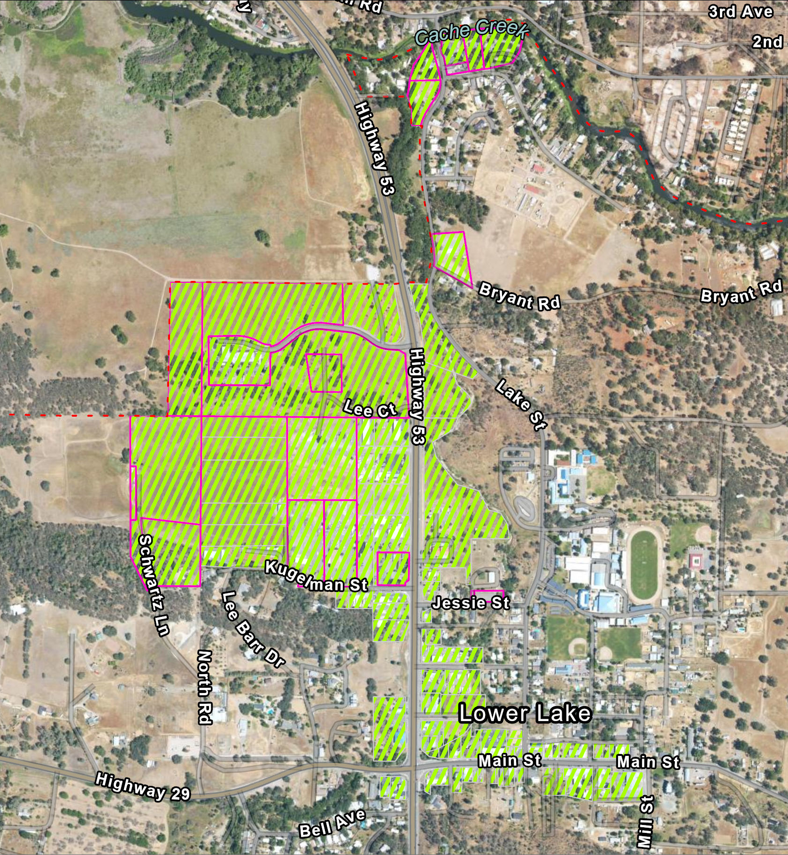
Potential Combining District Areas (Conceptual)

