Slide 1
Lake County 2050
General Plan Advisory Committee Meeting #3, Part 1
February 13, 2025

Slide 2
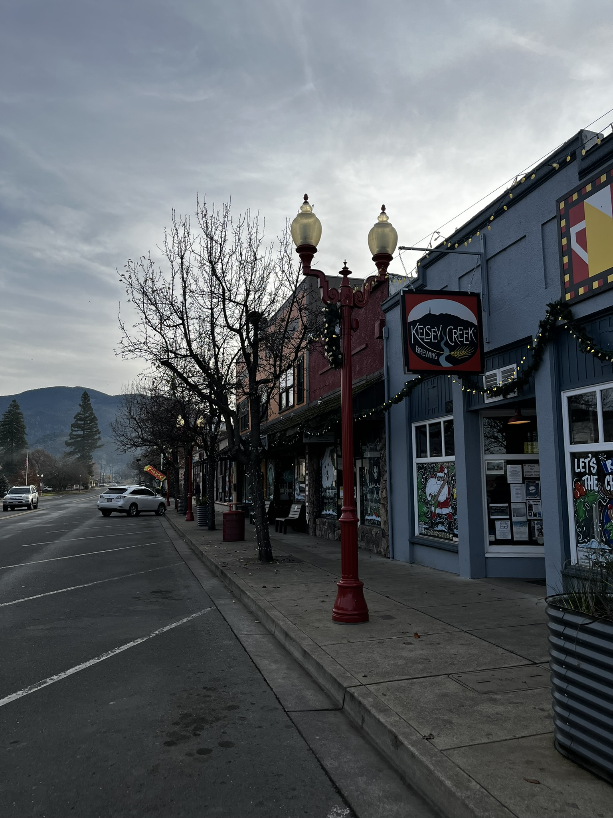
Meeting Overview
Welcome & Agenda Review
Project Updates
Countywide General Plan Land Use Map Overview
Community Questions and Answers
Review and Discuss General Plan Land Use Changes
Next Steps

Slide 3
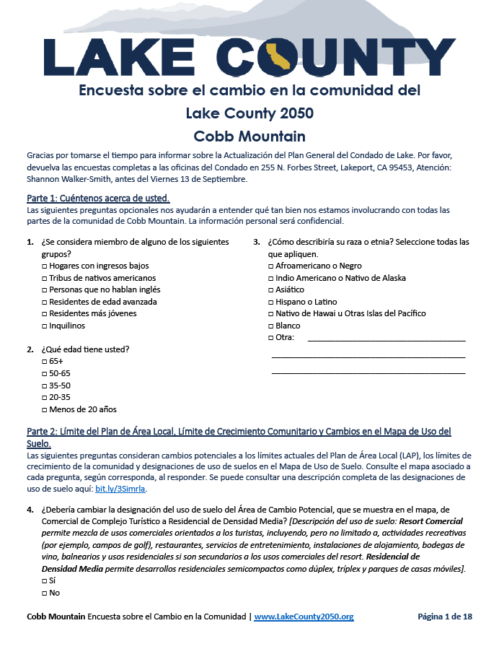
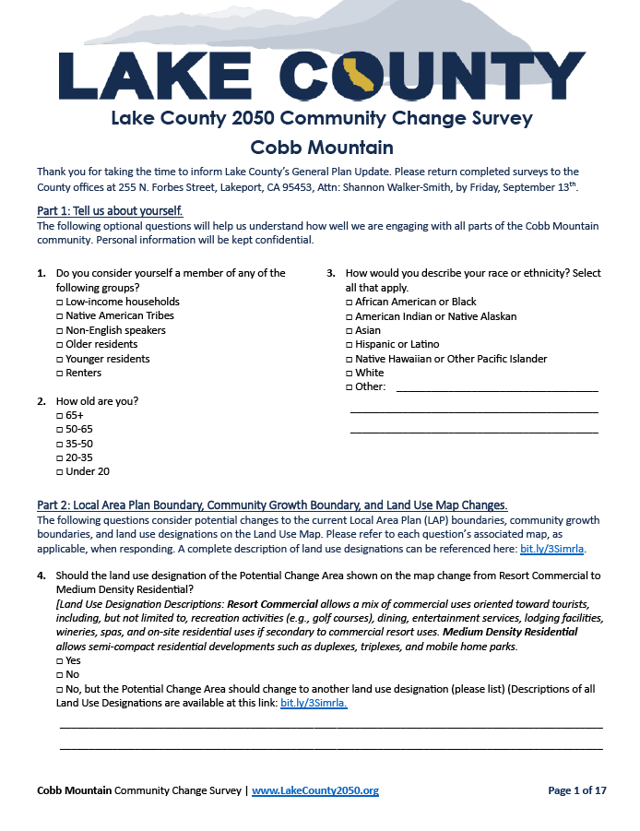
Project Updates Since GPAC Meeting 2
Summer 2024: Open House/Webinar series and tabling at local events to promote the 2nd set of community surveys
559 survey responses across all planning areas (English and Spanish)
August 2024: Local Area Plan Advisory Committees (LAPACs) formed by the County Board of Supervisors
September-January: LAPACs met to discuss survey results and provide direction on:
General Plan Land Use (GPLU) map changes
Planning Area Boundary changes
Community Growth Boundary (CGB) changes
Policy changes
Notes:
Last GPAC meeting was a two-part meeting in June and July 2024, and we discussed the GP Overview document and key policy issues.
Later that summer we conducted another round of community engagement through an open house and webinar series of meetings, plus tabling at local community events, all to promote the second set of community surveys, which were focused on potential changes to the land use map and policy options to address key issues we heard from the community during the first round of engagement.
The survey was conducted in English and Spanish and we had a high level of participation with 559 surveys completed.
Also later last summer the BOS formed advisory committees for individual LAPs, called LAPACs, and they each held multiple meetings starting in September through last month to… [see slide]

Slide 4
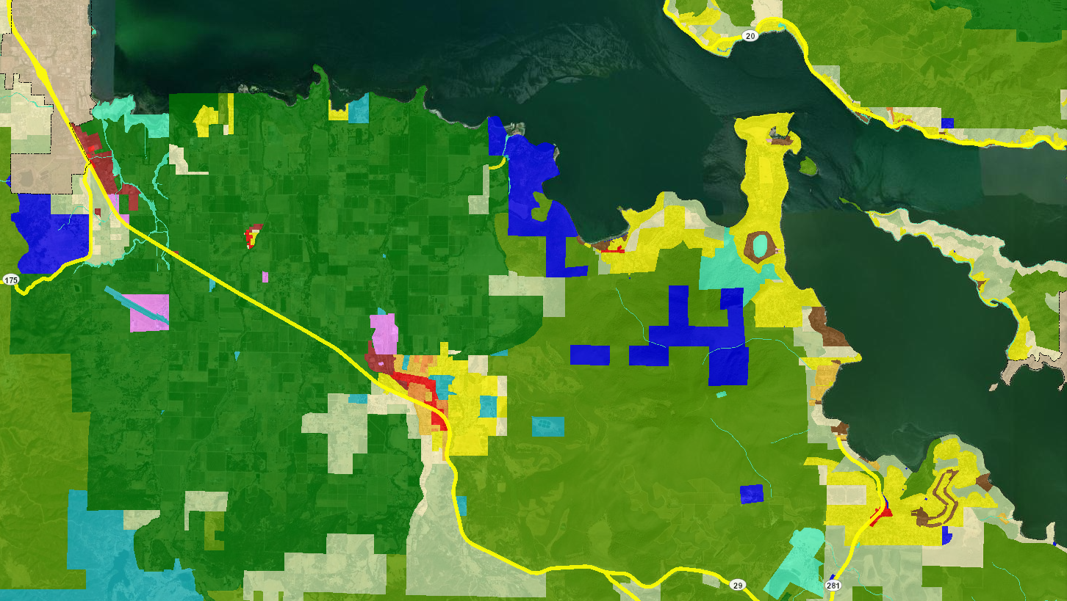
General Plan Land Use Map
Development standards for each land use designation
Maximum residential density (housing units per acre)
Maximum non-residential density (floor-to-area ratio, or FAR)
Provides the framework for the Zoning Code
Kelseyville/Rivieras Land Use Designations
Notes:
Today’s meeting is focused on reviewing the LAPAC recommendations on changes to the GPLU map.
So first I’ll start with an overview of what this map is so that we all have a shared understanding of what we’re talking about.
This map identifies what type of use can be developed on each parcel of land in the unincorporated county. EX – slide – dark green areas indicate areas that should remain in ag use, while yellow areas indicate LDR uses can be developed.
It also provides some basic parameters for how that land use can be developed:
For residential designations, it identifies a maximum density, which is the number of homes per acre that are allowed.
For non-residential designations like for commercial or industrial uses, it identifies the allowed intensity of development, typically through a limit on the ratio of floor area to lot size.
The GPLU map also establishes a framework for the more detailed zoning map that regulates land use and development in the county at a more fine-grained scale.

Slide 5
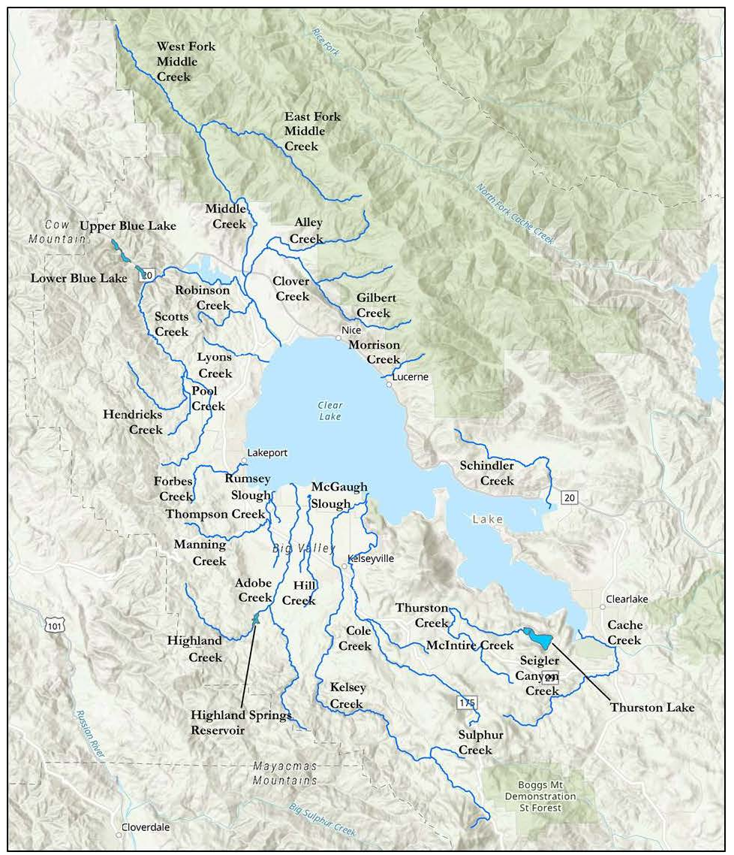
LAPAC Recommendations
Recommended GPLU changes incorporated into web map viewer for review today.
Also recommended application of Resource Conservation designation as a 20-foot buffer around Clear Lake and its tributaries as a conservation strategy for the Clear Lake Hitch.
This change is underway and not reflected in the map viewer.
Notes:
We shared an online web map viewer prior to this meeting via an email to the GPAC and an eblast to our project email list. This map viewer includes the recommended GPLU changes from the LAPACs, and are the focus of our discussion today.
We’ll switch to that viewer in a moment, but before we do, I wanted to highlight a recommended GPLU change that is not yet reflected in the map viewer (see slide).
Switch to web map viewer.

Slide 6
Map Review and Discussion
Discussion Question:
Looking at the Draft 2050 Land Use map and considering the hazard layers, are any adjustments needed to the proposed changes? Are there any additional changes that should be made?
Upper Lake-Nice
Lower Lake
Kelseyville
Middletown
Rivieras
Lakeport
Cobb Mountain
Shoreline Communities

Slide 7
Next Steps
Thursday, February 20: GPAC Meeting 3, Part 2
Consider additional GPLU changes based on analysis in the Housing Action and Implementation Plan (to consider new residential land uses)
Consider LAPAC-recommended Community Growth Boundary and Planning Area Boundary changes
Tuesday, February 25: Board of Supervisors Meeting
Review revised GPLU map and boundary changes
Phase | Schedule
Prepare Draft General Plan (including countywide and planning area elements) | Winter 2024/2025-Fall 2025
Prepare Environmental Impact Report | Spring 2025 – Winter 2025/2026
Public Review and Adoption | Spring – Fall 2026

Slide 8
GPAC Meetings Schedule
Meeting 1: March 15, 2024
Learn about Lake County 2050
Review roles and responsibilities
Review Community Engagement Plan
Meeting 2: June 28, 2024
Review Draft General Plan Overview Document
Provide input on key policy issues
Meeting 3: Today and February 20, 2025
Review Draft General Plan Map and Boundary Changes
Meeting 4: Winter/Spring 2026
Review Draft General Plan (Countywide Elements)
Meeting 5: Winter/Spring 2026
Review Draft General Plan (Planning Area Elements)

Slide 9
Thank You

